Slide 1


Boundless Lecture Slides
Available on the Boundless Teaching Platform
Free to share, print, make copies and changes. Get yours at www.boundless.com

Slide 2



Using Boundless Presentations
Boundless Teaching Platform
Boundless empowers educators to engage their students with affordable, customizable textbooks and intuitive teaching tools. The free Boundless Teaching Platform gives educators the ability to customize textbooks in more than 20 subjects that align to hundreds of popular titles. Get started by using high quality Boundless books, or make switching to our platform easier by building from Boundless content pre-organized to match the assigned textbook. This platform gives educators the tools they need to assign readings and assessments, monitor student activity, and lead their classes with pre-made teaching resources.
Get started now at:
The Appendix
The appendix is for you to use to add depth and breadth to your lectures. You can simply drag and drop slides from the appendix into the main presentation to make for a richer lecture experience.
http://boundless.com/teaching-platform
Free to edit, share, and copy
Feel free to edit, share, and make as many copies of the Boundless presentations as you like. We encourage you to take these presentations and make them your own.
If you have any questions or problems please email:
educators@boundless.com
Free to share, print, make copies and changes. Get yours at www.boundless.com

Slide 3

About Boundless
Boundless is an innovative technology company making education more affordable and accessible for students everywhere. The company creates the world’s best open educational content in 20+ subjects that align to more than 1,000 popular college textbooks. Boundless integrates learning technology into all its premium books to help students study more efficiently at a fraction of the cost of traditional textbooks. The company also empowers educators to engage their students more effectively through customizable books and intuitive teaching tools as part of the Boundless Teaching Platform. More than 2 million learners access Boundless free and premium content each month across the company’s wide distribution platforms, including its website, iOS apps, Kindle books, and iBooks. To get started learning or teaching with Boundless, visit boundless.com.
Free to share, print, make copies and changes. Get yours at www.boundless.com

Slide 4
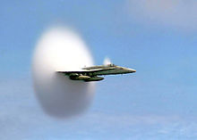
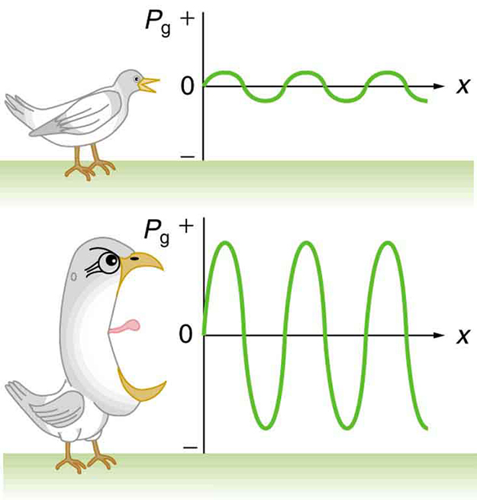
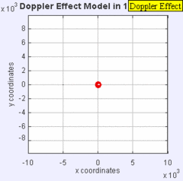
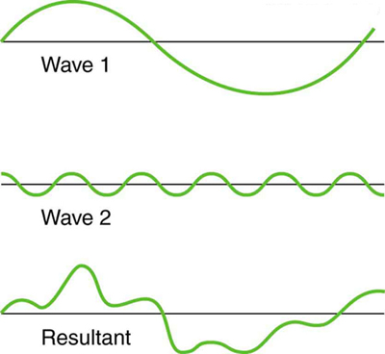
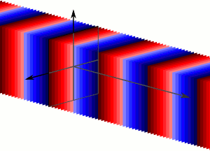

Sound
Introduction
Sound Intensity and Level
Doppler Effect and Sonic Booms
Interactions with Sound Waves
]
Further Topics
Sound
Free to share, print, make copies and changes. Get yours at www.boundless.com

Slide 5

Introduction
Sound > Introduction
Characteristics of Sound
Frequency of Sound Waves
Sound Production: Vibrating String and Air Columns
Quality of Sound
Speed of Sound
Free to share, print, make copies and changes. Get yours at www.boundless.com
www.boundless.com/physics/textbooks/boundless-physics-textbook/sound-16/introduction-128/

Slide 6
Sound Intensity and Level
Sound > Sound Intensity and Level
Intensity
Human Perception of Sound
Decibels
Free to share, print, make copies and changes. Get yours at www.boundless.com
www.boundless.com/physics/textbooks/boundless-physics-textbook/sound-16/sound-intensity-and-level-129/

Slide 7
Doppler Effect and Sonic Booms
Sound > Doppler Effect and Sonic Booms
Moving Observer
Moving Source
General Case
Sonic Booms
Free to share, print, make copies and changes. Get yours at www.boundless.com
www.boundless.com/physics/textbooks/boundless-physics-textbook/sound-16/doppler-effect-and-sonic-booms-130/

Slide 8
Interactions with Sound Waves
Sound > Interactions with Sound Waves
Superposition
Interference
Beats
The Ear
Applications: Ultrasound, Sonar, and Medical Imaging
Free to share, print, make copies and changes. Get yours at www.boundless.com
www.boundless.com/physics/textbooks/boundless-physics-textbook/sound-16/interactions-with-sound-waves-131/

Slide 9
Further Topics
Sound > Further Topics
Spherical and Plane Waves
Standing Waves on a String
Standing Waves in Air Columns
Forced Vibrations and Resonance
Free to share, print, make copies and changes. Get yours at www.boundless.com
www.boundless.com/physics/textbooks/boundless-physics-textbook/sound-16/further-topics-132/

Slide 10
Appendix
Free to share, print, make copies and changes. Get yours at www.boundless.com

Slide 11
Key terms
Sound
amplitude The maximum absolute value of some quantity that varies.
amplitude The maximum absolute value of some quantity that varies.
antinode A region of maximum amplitude situated between adjacent nodes of a vibrating body, such as a string
antinode A region of maximum amplitude situated between adjacent nodes of a vibrating body, such as a string
classical physics All aspects of physics developed before the rise of quantum mechanics.
cochlea The complex, spirally coiled, tapered cavity of the inner ear in which sound vibrations are converted into nerve impulses.
coherent Of waves having the same direction, wavelength and phase, as light in a laser.
constructive interference Occurs when waves interfere with each other crest to crest and the waves are exactly in phase with each other.
constructive interference Occurs when waves interfere with each other crest to crest and the waves are exactly in phase with each other.
damping The reduction in the magnitude of oscillations by the dissipation of energy
decibel A common measure of sound intensity that is one tenth of a bel on the logarithmic intensity scale. It is defined as dB = 10 * log10(P 1/P 2), where P1 and P2 are the relative powers of the sound.
decibel A common measure of sound intensity that is one tenth of a bel on the logarithmic intensity scale. It is defined as dB = 10 * log10(P 1/P 2), where P1 and P2 are the relative powers of the sound.
Free to share, print, make copies and changes. Get yours at www.boundless.com

Slide 12
Sound
destructive interference Occurs when waves interfere with each other crest to trough (peak to valley) and are exactly out of phase with each other.
destructive interference Occurs when waves interfere with each other crest to trough (peak to valley) and are exactly out of phase with each other.
displacement A vector quantity that denotes distance with a directional component.
doppler effect Apparent change in frequency of a wave when the observer and the source of the wave move relative to each other.
doppler effect Apparent change in frequency of a wave when the observer and the source of the wave move relative to each other.
doppler effect Apparent change in frequency of a wave when the observer and the source of the wave move relative to each other.
eardrum A thin membrane that separates the outer ear from the middle ear and transmits sound from the air to the malleus.
elasticity The property by virtue of which a material deformed under the load can regain its original dimensions when unloaded
epithelium a membranous tissue composed of one or more layers of cells that forms the covering of most internal and external surfaces of the body and its organs (internally, the lining of vessels and other small cavities; externally, the skin)
frequency The quotient of the number of times n a periodic phenomenon occurs over the time t in which it occurs: f = n / t.
frequency The quotient of the number of times n a periodic phenomenon occurs over the time t in which it occurs: f = n / t.
frequency The quotient of the number of times (n) a periodic phenomenon occurs over a unit of time (t): f = n / t.
Free to share, print, make copies and changes. Get yours at www.boundless.com

Slide 13
Sound
frequency The quotient of the number of times n a periodic phenomenon occurs over the time t in which it occurs: f = n / t.
frequency The quotient of the number of times n a periodic phenomenon occurs over the time t in which it occurs: f = n / t.
Hertz Measurement of sound frequency.
Hertz In the International System of Units, the derived unit of frequency; one (period or cycle of any periodic event) per second. Symbol: Hz
interfere (of waves) To be correlated with each other when overlapped or superposed.
kelvin in the International System of Units, the base unit of thermodynamic temperature; 1/273.16 of the thermodynamic temperature of the triple point of water; symbolized as K
Mach number The ratio of the velocity of a body to that of sound in the surrounding medium.
media General term for different types of materials.
natural frequency The frequency at which a system vibrates on its own. For a spring (spring constant k) with an object of mass m attached, the natural frequency is given as .
nerve impulse the signal transmitted along a nerve fiber, either in response to a stimulus (such as touch, pain, or heat), or as an instruction (such as causing a muscle to contract)
neurotransmitter any substance, such as acetylcholine or dopamine, responsible for sending nerve signals across a synapse between two neurons
node Point on a wave where there is no displacement.
Free to share, print, make copies and changes. Get yours at www.boundless.com

Slide 14
Sound
node Point on a wave where there is no displacement.
Objective measurement Taken by tools to gauge accuracy.
period The duration of one cycle in a repeating event.
phon A unit of apparent loudness, equal in number to the intensity in decibels of a 1,000-hertz tone judged to be as loud as the sound being measured.
sonic boom The audible effect of a shock wave in the air, especially one caused by an aircraft flying faster then the speed of sound
Subjective measurement Based on a comparison to a previous experience, opinion.
superimpose To place an object over another object.
superposition The summing of two or more field contributions occupying the same space.
The Doppler Effect Apparent change in frequency of a wave when the observer and the source of the wave move relative to each other.
transverse wave Any wave in which the direction of disturbance is perpendicular to the direction of travel.
wavefront An imaginary surface passing through points of a medium oscillating in phase.
Free to share, print, make copies and changes. Get yours at www.boundless.com

Slide 15
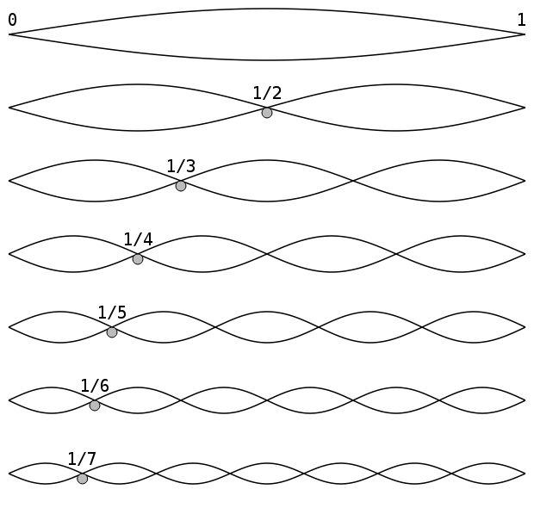

Sound
Standing Waves in a String
Vibration, standing waves in a string. The fundamental and the first 6 overtones form a harmonic series.
Free to share, print, make copies and changes. Get yours at www.boundless.com
Wikipedia. "Harmonic partials on strings." Public domain http://en.wikipedia.org/wiki/File:Harmonic_partials_on_strings.svg View on Boundless.com

Slide 16
Sound
Plane Wave
Plane waves are an infinite number of wavefronts normal to the direction of the propogation.
Free to share, print, make copies and changes. Get yours at www.boundless.com
Wikipedia. "Plane Wave 3D Animation 300x216 255Colors." Public domain http://en.wikipedia.org/wiki/File:Plane_Wave_3D_Animation_300x216_255Colors.gif View on Boundless.com

Slide 17
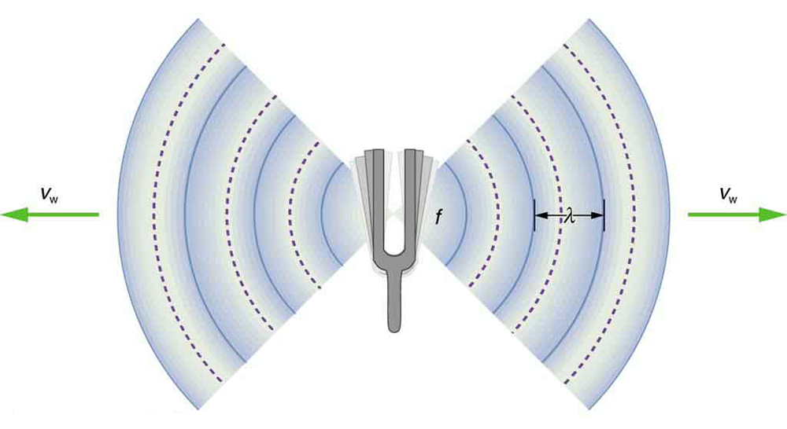
Sound
Frequency
A sound wave emanates from a source vibrating at a frequency f, propagates at v, and has a wavelength λ.
Free to share, print, make copies and changes. Get yours at www.boundless.com
OpenStax CNX. "OpenStax College, Speed of Sound, Frequency, and Wavelength. December 23, 2012." CC BY 3.0 http://cnx.org/content/m42256/latest/ View on Boundless.com

Slide 18
Sound
Sound Intensity
Graphs of the gauge pressures in two sound waves of different intensities. The more intense sound is produced by a source that has larger-amplitude oscillations and has greater pressure maxima and minima. Because pressures are higher in the greater-intensity sound, it can exert larger forces on the objects it encounters
Free to share, print, make copies and changes. Get yours at www.boundless.com
OpenStax CNX. "OpenStax College, Sound Intensity and Sound Level. December 24, 2012." CC BY 3.0 http://cnx.org/content/m42257/latest/ View on Boundless.com

Slide 19
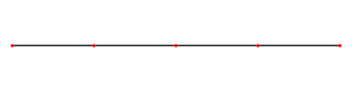
Sound
Standing Wave on a String
This is what a standing wave would look like if you were to slow it down. The wave is caused by an incident wave on a string being reflected and then traveling back in the direction it came from. The two waves then meet and interfere with each other causing this phenomenon.
Free to share, print, make copies and changes. Get yours at www.boundless.com
Wikipedia. "Standing wave." Public domain http://en.wikipedia.org/wiki/File:Standing_wave.gif View on Boundless.com

Slide 20
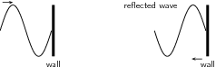
Sound
Fixed End Reflection
When a transverse wave meets a fixed end, the wave is reflected, but inverted.
Free to share, print, make copies and changes. Get yours at www.boundless.com
OpenStax CNX. "Rory Adams (Free High School Science Texts Project), Mark Horner, and Heather Williams, Transverse Waves - Grade 10. February 2, 2013." CC BY 3.0 http://cnx.org/content/m32635/latest/ View on Boundless.com

Slide 21
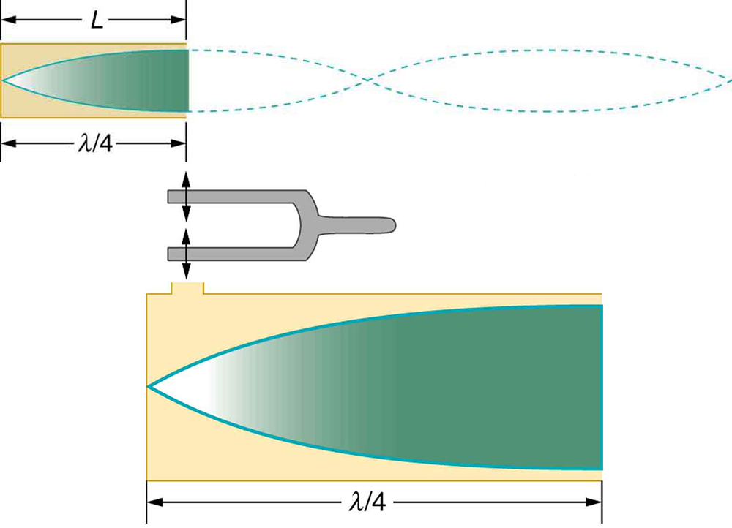
Sound
Standing Wave in Air Column
The same standing wave is created in the tube by a vibration introduced near its closed end.
Free to share, print, make copies and changes. Get yours at www.boundless.com
OpenStax CNX. "OpenStax College, Sound Interference and Resonance: Standing Waves in Air Columns. February 23, 2013." CC BY 3.0 http://cnx.org/content/m42296/latest/ View on Boundless.com

Slide 22
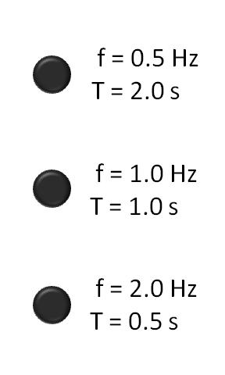
Sound
Frequency Animation
Three flashing lights, from lowest frequency (top) to highest frequency (bottom). f is the frequency in hertz (Hz); or the number of cycles per second. T is the period in seconds (s); or the number of seconds per cycle. T and f are reciprocals.
Free to share, print, make copies and changes. Get yours at www.boundless.com
Wikipedia. "FrequencyAnimation." Public domain http://en.wikipedia.org/wiki/File:FrequencyAnimation.gif View on Boundless.com

Slide 23
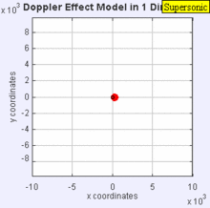
Sound
Sonic Boom Gif
The sound source has now broken through the sound speed barrier, and is traveling at 1.4 times the speed of sound, (Mach 1.4). Since the source is moving faster (with a speed ) than the sound waves it creates, it actually leads the advancing wavefront. The sound source will pass by a stationary observer (with a speed ) before the observer actually hears the sound it creates.
Free to share, print, make copies and changes. Get yours at www.boundless.com
Wikipedia. "Sonic boom." GNU FDL http://en.wikipedia.org/wiki/Sonic_boom View on Boundless.com

Slide 24
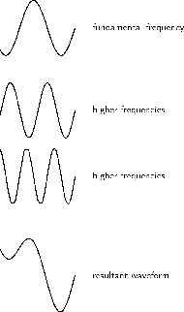
Sound
Sound Frequencies
The quality of a tone depends on its mixture of harmonics.
Free to share, print, make copies and changes. Get yours at www.boundless.com
OpenStax CNX. "Free High School Science Texts Project, The Physics of Musics: Resonance and Sound Quality. December 23, 2012." CC BY 3.0 http://cnx.org/content/m39050/latest/ View on Boundless.com

Slide 25
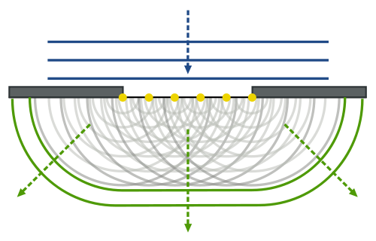
Sound
Huygen-Fresnel Principle
The Huygen-Fresnel Principle uses the law of refraction. Each point on the wave produces waves which interfere with each other either constructively or destructively.
Free to share, print, make copies and changes. Get yours at www.boundless.com
Wikipedia. "Refraction on an aperture - Huygens-Fresnel principle." CC BY-SA http://en.wikipedia.org/wiki/File:Refraction_on_an_aperture_-_Huygens-Fresnel_principle.svg View on Boundless.com

Slide 26
Sound
Breaking the Sound Barrier
This familiar image is of a plane that is moving faster than the speed of sound.
Free to share, print, make copies and changes. Get yours at www.boundless.com
Wikipedia. "FA-18 Hornet breaking sound barrier (7 July 1999) - filtered." Public domain http://en.wikipedia.org/wiki/File:FA-18_Hornet_breaking_sound_barrier_(7_July_1999)_-_filtered.jpg View on Boundless.com

Slide 27
Sound
Faster than the Speed of Sound
This is a jet that is just about to break the sound barrier.
Free to share, print, make copies and changes. Get yours at www.boundless.com
Wikipedia. "FA-18 Hornet breaking sound barrier (7 July 1999) - filtered." Public domain http://en.wikipedia.org/wiki/File:FA-18_Hornet_breaking_sound_barrier_(7_July_1999)_-_filtered.jpg View on Boundless.com

Slide 28
Sound
The Doppler Effect
The same sound source is radiating sound waves at a constant frequency in the same medium. However, now the sound source is moving to the right with a speed υs = 0.7 c (Mach 0.7). The wave-fronts are produced with the same frequency as before. However, since the source is moving, the centre of each new wavefront is now slightly displaced to the right. As a result, the wave-fronts begin to bunch up on the right side (in front of) and spread further apart on the left side (behind) of the source.
Free to share, print, make copies and changes. Get yours at www.boundless.com
Wikipedia. "Dopplereffectsourcemovingrightatmach0.7." CC BY-SA http://en.wikipedia.org/wiki/File:Dopplereffectsourcemovingrightatmach0.7.gif View on Boundless.com

Slide 29
Sound
Superposition of Non-Identical Waves
Superposition of non-identical waves exhibits both constructive and destructive interference.
Free to share, print, make copies and changes. Get yours at www.boundless.com
OpenStax CNX. "OpenStax College, Superposition and Interference. January 16, 2015." CC BY 3.0 http://cnx.org/content/m42249/latest/ View on Boundless.com

Slide 30
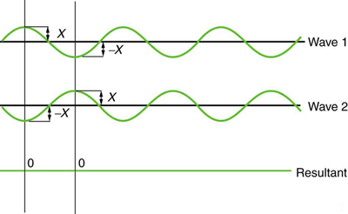
Sound
Superposition
Superposition is when two waves add together. In this figure, the two waves add together and cancel out leaving no wave. This is destructive interference.
Free to share, print, make copies and changes. Get yours at www.boundless.com
OpenStax CNX. "OpenStax College, Superposition and Interference. January 16, 2015." CC BY 3.0 http://cnx.org/content/m42249/latest/ View on Boundless.com

Slide 31
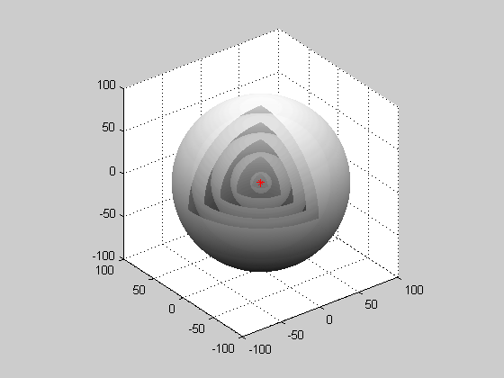
Sound
Spherical Wave
When waves are produced from a point source, they are spherical waves.
Free to share, print, make copies and changes. Get yours at www.boundless.com
Wikipedia. "Spherical Wave." CC BY-SA http://en.wikipedia.org/wiki/File:Spherical_Wave.gif View on Boundless.com

Slide 32
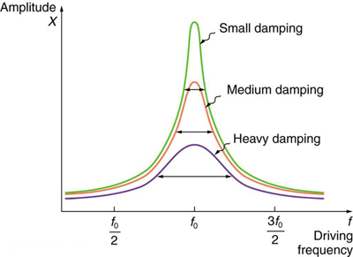
Sound
Damping
The amplitude of a harmonic oscillator is a function of the frequency of the driving force. The curves represent the same oscillator with the same natural frequency but with different amounts of damping. Resonance occurs when the driving frequency equals the natural frequency, and the greatest response is for the least amount of damping. The narrowest response is also for the least amount of damping.
Free to share, print, make copies and changes. Get yours at www.boundless.com
OpenStax CNX. "OpenStax College, Forced Oscillations and Resonance. February 23, 2013." CC BY 3.0 http://cnx.org/content/m42247/latest/ View on Boundless.com

Slide 33
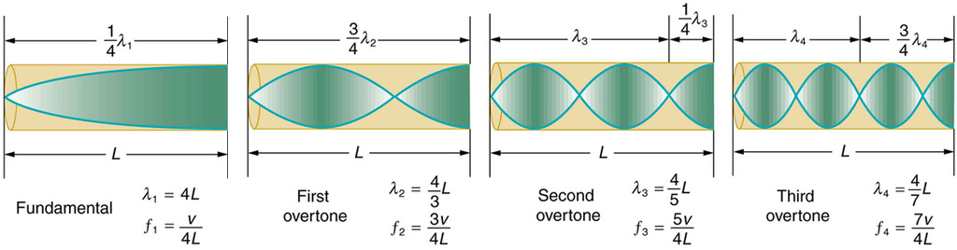
Sound
An Air column in a tube closed at one end
The fundamental and three lowest overtones for a tube closed at one end. All have maximum air displacements at the open end and none at the closed end.
Free to share, print, make copies and changes. Get yours at www.boundless.com
OpenStax CNX. "OpenStax College, Sound Interference and Resonance: Standing Waves in Air Columns. December 23, 2012." CC BY 3.0 http://cnx.org/content/m42296/latest/ View on Boundless.com

Slide 34
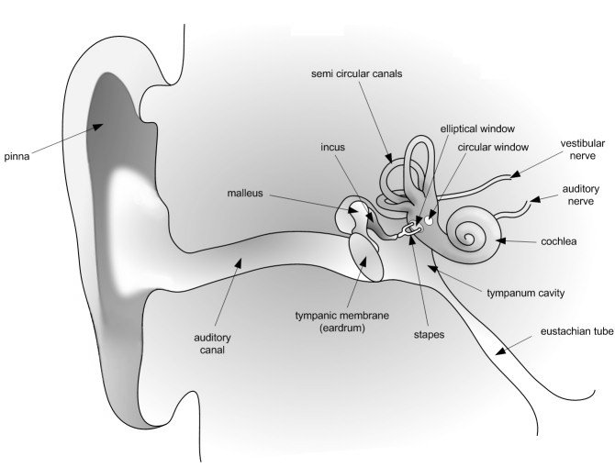
Sound
The Human Ear
A detailed diagram of the human ear.
Free to share, print, make copies and changes. Get yours at www.boundless.com
OpenStax CNX. "Rory Adams, Free High School Science Texts Project, Mark Horner, and Heather Williams, Sound - Grade 11. December 24, 2012." CC BY 3.0 http://cnx.org/content/m32834/latest/ View on Boundless.com

Slide 35
Sound
The Doppler Effect
The same sound source is radiating sound waves at a constant frequency in the same medium. However, now the sound source is moving to the right with a speed υs = 0.7 c (Mach 0.7). The wave-fronts are produced with the same frequency as before. However, since the source is moving, the centre of each new wavefront is now slightly displaced to the right. As a result, the wave-fronts begin to bunch up on the right side (in front of) and spread further apart on the left side (behind) of the source.
Free to share, print, make copies and changes. Get yours at www.boundless.com
Wikipedia. "Dopplereffectsourcemovingrightatmach0.7." CC BY-SA http://en.wikipedia.org/wiki/File:Dopplereffectsourcemovingrightatmach0.7.gif View on Boundless.com

Slide 36
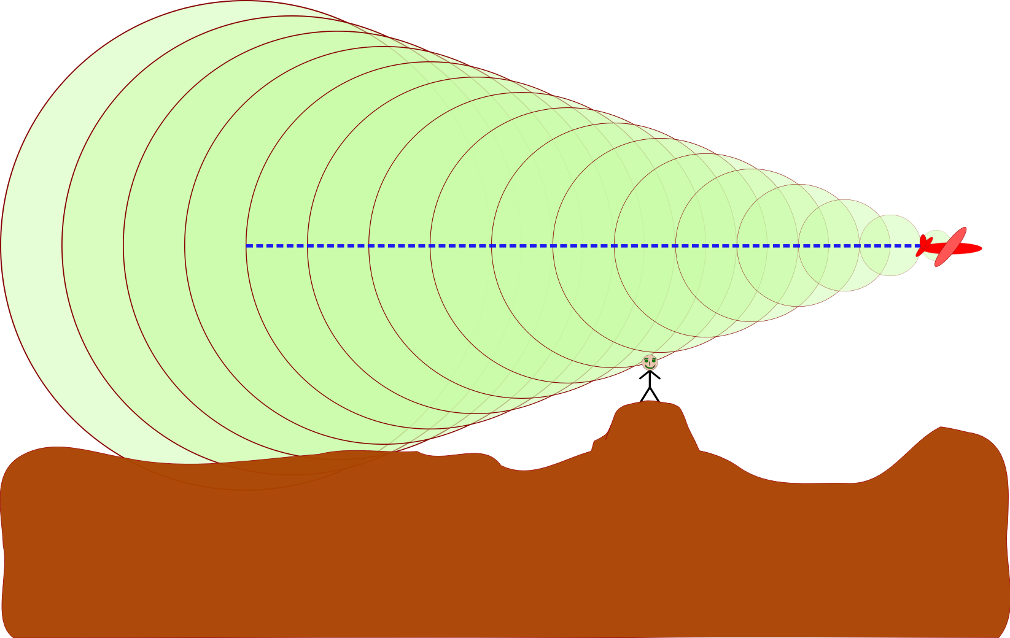
Sound
Sonic Boom
A sonic boom produced by an aircraft moving at M=2.92, calculated from the cone angle of 20 degrees. An observer hears the boom when the shock wave, on the edges of the cone, crosses his or her location
Free to share, print, make copies and changes. Get yours at www.boundless.com
Wikipedia. "Sonic boom." GNU FDL http://en.wikipedia.org/wiki/File:Sonic_boom.svg View on Boundless.com

Slide 37
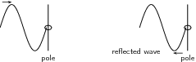
Sound
Free End Reflection
The wave is reflected, but unlike a transverse wave with a fixed end, it is not inverted.
Free to share, print, make copies and changes. Get yours at www.boundless.com
OpenStax CNX. "Rory Adams (Free High School Science Texts Project), Mark Horner, and Heather Williams, Transverse Waves - Grade 10. February 2, 2013." CC BY 3.0 http://cnx.org/content/m32635/latest/ View on Boundless.com

Slide 38

Sound
Interference
Two overlapping waves exhibit interference.
Free to share, print, make copies and changes. Get yours at www.boundless.com
Wikipedia. "Interference." CC BY http://en.wikipedia.org/wiki/Interference View on Boundless.com

Slide 39
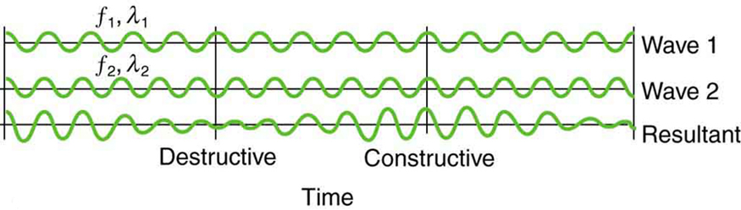
Sound
Beat Frequency
Beats are produced by the superposition of two waves of slightly different frequencies but identical amplitudes.The waves alternate in time between constructive interference and destructive interference, giving the resulting wave a time-varying amplitude.
Free to share, print, make copies and changes. Get yours at www.boundless.com
OpenStax CNX. "OpenStax College, Superposition and Interference. February 9, 2013." CC BY 3.0 http://cnx.org/content/m42249/latest/Figure_17_10_08a.jpg View on Boundless.com

Slide 40
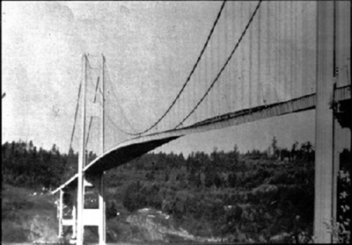
Sound
Collapse of the Tacoma Narrows Bridge
In 1940, the Tacoma Narrows Bridge in Washington state collapsed. Heavy cross winds drove the bridge into oscillations at its resonant frequency. The damping decreased when support cables broke loose and started to slip over the towers, allowing increasingly greater amplitudes until the structure failed. (credit: PRI's Studio 360, via Flickr)
Free to share, print, make copies and changes. Get yours at www.boundless.com
OpenStax CNX. "OpenStax College, Forced Oscillations and Resonance. February 23, 2013." CC BY 3.0 http://cnx.org/content/m42247/latest/ View on Boundless.com

Slide 41
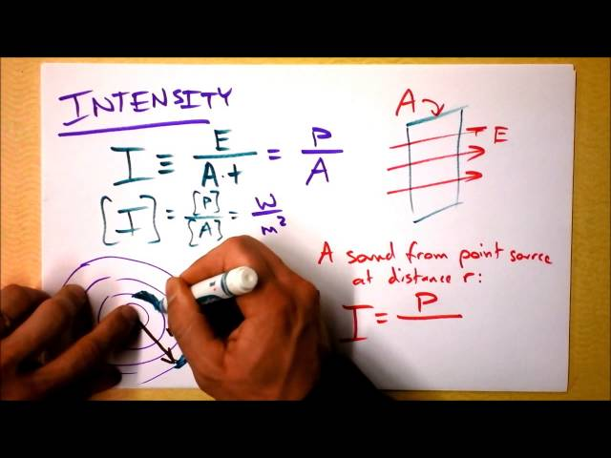
Sound
Sound Intensity and Decibels
Free to share, print, make copies and changes. Get yours at www.boundless.com
View on Boundless.com

Slide 42
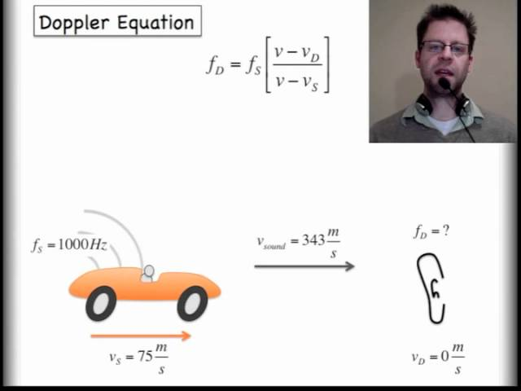
Sound
Sound and the Doppler Effect
This video introduces sound waves. The first video describes the basics of sound while the second video looks at the Doppler Effect.
Free to share, print, make copies and changes. Get yours at www.boundless.com
View on Boundless.com

Slide 43
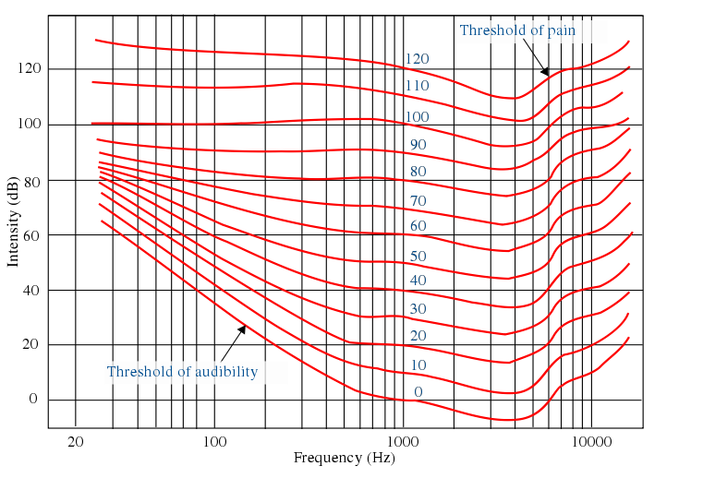
Sound
The Fletcher Munson Chart
The Fletcher-Munson equal-loudness contours. Phons are labelled in blue
Free to share, print, make copies and changes. Get yours at www.boundless.com
Wikibooks. "Physics Study Guide/Sound." CC BY-SA 3.0 http://en.wikibooks.org/wiki/Physics_Study_Guide/Sound View on Boundless.com

Slide 44
Sound
The First Four Harmonics
The fundamental and three lowest overtones for a tube closed at one end. All have maximum air displacements at the open end and none at the closed end.
Free to share, print, make copies and changes. Get yours at www.boundless.com
OpenStax CNX. "OpenStax College, Sound Interference and Resonance: Standing Waves in Air Columns. February 23, 2013." CC BY 3.0 http://cnx.org/content/m42296/latest/ View on Boundless.com

Slide 45
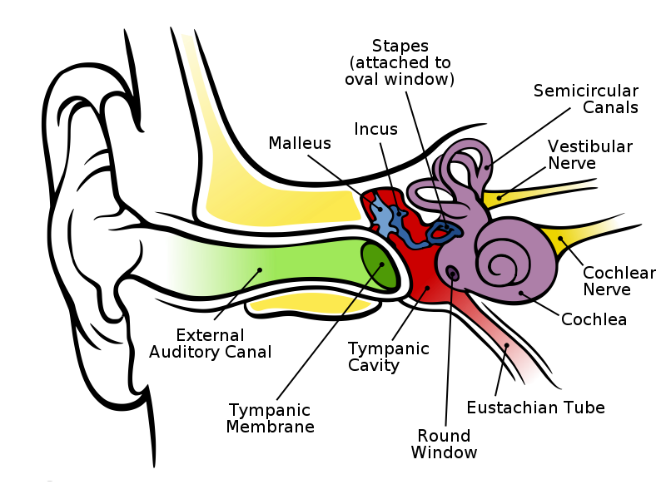
Sound
Anatomy of the Human Ear
Anatomy of the human ear; the length of the auditory canal is exaggerated for viewing purposes
Free to share, print, make copies and changes. Get yours at www.boundless.com
Wikipedia. "Anatomy of the Human Ear." CC BY 2.5 http://en.wikipedia.org/wiki/File:Anatomy_of_the_Human_Ear.svg View on Boundless.com

Slide 46
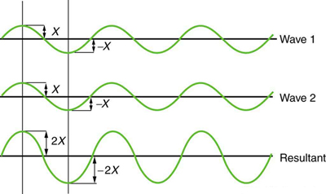
Sound
Constructive Interference
Pure constructive interference of two identical waves produces one with twice the amplitude, but the same wavelength.
Free to share, print, make copies and changes. Get yours at www.boundless.com
OpenStax CNX. "OpenStax College, Superposition and Interference. February 6, 2013." CC BY 3.0 http://cnx.org/content/m42249/latest/ View on Boundless.com

Slide 47
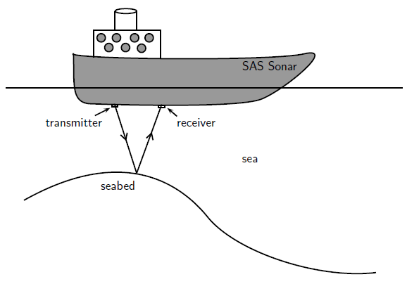
Sound
Sonar
Ships on the ocean make use of the reflecting properties of sound waves to determine the depth of the ocean. A sound wave is transmitted and bounces off the seabed. Because the speed of sound is known and the time lapse between sending and receiving the sound can be measured, the distance from the ship to the bottom of the ocean can be determined.
Free to share, print, make copies and changes. Get yours at www.boundless.com
OpenStax CNX. "Free High School Science Texts Project, Sound: Applications. February 8, 2013." CC BY 3.0 http://cnx.org/content/m38800/latest/PG11C5_005.png View on Boundless.com

Slide 48
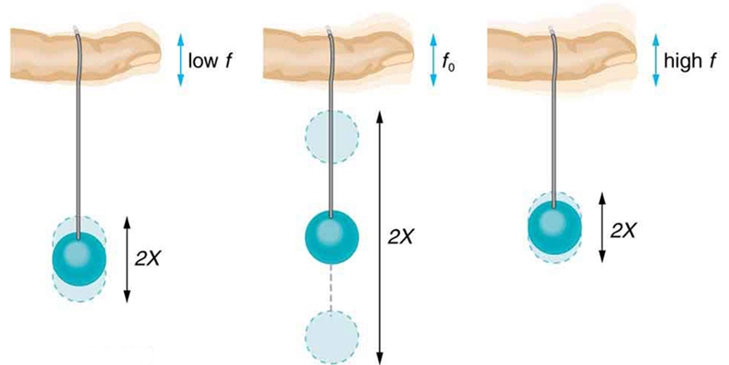
Sound
Paddle Balls and Frequencies
The paddle ball on its rubber band moves in response to the finger supporting it. If the finger moves with the natural frequency f0 of the ball on the rubber band, then a resonance is achieved, and the amplitude of the ball's oscillations increases dramatically. At higher and lower driving frequencies, energy is transferred to the ball less efficiently, and it responds with lower-amplitude oscillations.
Free to share, print, make copies and changes. Get yours at www.boundless.com
OpenStax CNX. "OpenStax College, Forced Oscillations and Resonance. February 23, 2013." CC BY 3.0 http://cnx.org/content/m42247/latest/ View on Boundless.com

Slide 49
Sound
The Doppler Effect
The same sound source is radiating sound waves at a constant frequency in the same medium. However, now the sound source is moving to the right with a speed υs = 0.7 c (Mach 0.7). The wave-fronts are produced with the same frequency as before. However, since the source is moving, the centre of each new wavefront is now slightly displaced to the right. As a result, the wave-fronts begin to bunch up on the right side (in front of) and spread further apart on the left side (behind) of the source.
Free to share, print, make copies and changes. Get yours at www.boundless.com
Wikipedia. "Dopplereffectsourcemovingrightatmach0.7." CC BY-SA http://en.wikipedia.org/wiki/File:Dopplereffectsourcemovingrightatmach0.7.gif View on Boundless.com

Slide 50
Attribution
Sound
Wiktionary. "frequency." CC BY-SA 3.0 http://en.wiktionary.org/wiki/frequency
OpenStax CNX. "Free High School Science Texts Project, Sound: Applications. September 17, 2013." CC BY 3.0 http://cnx.org/content/m38800/latest/
OpenStax CNX. "Free High School Science Texts Project, Sound: Applications. September 17, 2013." CC BY 3.0 http://cnx.org/content/m38800/latest/
Wiktionary. "damping." CC BY-SA 3.0 http://en.wiktionary.org/wiki/damping
Boundless Learning. "Boundless." CC BY-SA 3.0 http://www.boundless.com//physics/definition/natural-frequency
OpenStax CNX. "OpenStax College, Forced Oscillations and Resonance. September 17, 2013." CC BY 3.0 http://cnx.org/content/m42247/latest/
Boundless Learning. "Boundless." CC BY-SA 3.0 http://www.boundless.com//physics/definition/objective-measurement
Boundless Learning. "Boundless." CC BY-SA 3.0 http://www.boundless.com//physics/definition/subjective-measurement
OpenStax CNX. "Free High School Science Texts Project, The Physics of Musics: Resonance and Sound Quality. September 17, 2013." CC BY 3.0 http://cnx.org/content/m39050/latest/
Wikipedia. "Sound quality." CC BY-SA 3.0 http://en.wikipedia.org/wiki/Sound_quality
Wiktionary. "interfere." CC BY-SA 3.0 http://en.wiktionary.org/wiki/interfere
Wiktionary. "frequency." CC BY-SA 3.0 http://en.wiktionary.org/wiki/frequency
Boundless Learning. "Boundless." CC BY-SA 3.0 http://www.boundless.com//physics/definition/superposition
OpenStax CNX. "OpenStax College, Superposition and Interference. September 17, 2013." CC BY 3.0 http://cnx.org/content/m42249/latest/
Wiktionary. "amplitude." CC BY-SA 3.0 http://en.wiktionary.org/wiki/amplitude
Wiktionary. "decibel." CC BY-SA 3.0 http://en.wiktionary.org/wiki/decibel
OpenStax CNX. "OpenStax College, Sound Intensity and Sound Level. September 17, 2013." CC BY 3.0 http://cnx.org/content/m42257/latest/
Free to share, print, make copies and changes. Get yours at www.boundless.com

Slide 51
Sound
Wiktionary. "wavefront." CC BY-SA 3.0 http://en.wiktionary.org/wiki/wavefront
Boundless Learning. "Boundless." CC BY-SA 3.0 http://www.boundless.com//physics/definition/destructive-interference
Boundless Learning. "Boundless." CC BY-SA 3.0 http://www.boundless.com//physics/definition/constructive-interference
Wikipedia. "Plane waves." CC BY-SA 3.0 http://en.wikipedia.org/wiki/Plane_waves
Wikipedia. "Huygens principle." CC BY-SA 3.0 http://en.wikipedia.org/wiki/Huygens_principle
Wikipedia. "Plane wave." CC BY-SA 3.0 http://en.wikipedia.org/wiki/Plane_wave
Wiktionary. "sonic boom." CC BY-SA 3.0 http://en.wiktionary.org/wiki/sonic_boom
Wiktionary. "Mach number." CC BY-SA 3.0 http://en.wiktionary.org/wiki/Mach_number
Boundless Learning. "Boundless." CC BY-SA 3.0 http://www.boundless.com//physics/definition/doppler-effect--2
Wikipedia. "Sonic boom." CC BY-SA 3.0 http://en.wikipedia.org/wiki/Sonic_boom
Wikipedia. "Sonic boom." CC BY-SA 3.0 http://en.wikipedia.org/wiki/Sonic_boom
Wiktionary. "superimpose." CC BY-SA 3.0 http://en.wiktionary.org/wiki/superimpose
OpenStax CNX. "OpenStax College, Superposition and Interference. September 17, 2013." CC BY 3.0 http://cnx.org/content/m42249/latest/
OpenStax CNX. "OpenStax College, Superposition and Interference. September 17, 2013." CC BY 3.0 http://cnx.org/content/m42249/latest/
Wikipedia. "Superposition principle." CC BY-SA 3.0 http://en.wikipedia.org/wiki/Superposition_principle%23Application_to_waves
Wiktionary. "nerve impulse." CC BY-SA 3.0 http://en.wiktionary.org/wiki/nerve_impulse
Wiktionary. "neurotransmitter." CC BY-SA 3.0 http://en.wiktionary.org/wiki/neurotransmitter
Wiktionary. "epithelium." CC BY-SA 3.0 http://en.wiktionary.org/wiki/epithelium
Wikipedia. "Ear." CC BY-SA 3.0 http://en.wikipedia.org/wiki/Ear
Free to share, print, make copies and changes. Get yours at www.boundless.com

Slide 52
Sound
OpenStax CNX. "Catherine Schmidt-Jones, Sound and Ears. September 17, 2013." CC BY 3.0 http://cnx.org/content/m12365/latest/
Wiktionary. "coherent." CC BY-SA 3.0 http://en.wiktionary.org/wiki/coherent
Wiktionary. "displacement." CC BY-SA 3.0 http://en.wiktionary.org/wiki/displacement
Wiktionary. "amplitude." CC BY-SA 3.0 http://en.wiktionary.org/wiki/amplitude
Wikipedia. "Superposition." CC BY-SA 3.0 http://en.wikipedia.org/wiki/Superposition
Wiktionary. "cochlea." CC BY-SA 3.0 http://en.wiktionary.org/wiki/cochlea
Wiktionary. "eardrum." CC BY-SA 3.0 http://en.wiktionary.org/wiki/eardrum
OpenStax CNX. "Rory Adams, Free High School Science Texts Project, Mark Horner, and Heather Williams, Sound - Grade 11. September 18, 2013." CC BY 3.0 http://cnx.org/content/m32834/latest/
Wikipedia. "Psychoacoustics." CC BY-SA 3.0 http://en.wikipedia.org/wiki/Psychoacoustics
Wiktionary. "antinode." CC BY-SA 3.0 http://en.wiktionary.org/wiki/antinode
Boundless Learning. "Boundless." CC BY-SA 3.0 http://www.boundless.com//physics/definition/node
Wikipedia. "Wind instrument." CC BY-SA 3.0 http://en.wikipedia.org/wiki/Wind_instrument
Wikipedia. "Vibrating string." CC BY-SA 3.0 http://en.wikipedia.org/wiki/Vibrating_string
OpenStax CNX. "OpenStax College, Sound Interference and Resonance: Standing Waves in Air Columns. September 18, 2013." CC BY 3.0 http://cnx.org/content/m42296/latest/
OpenStax CNX. "OpenStax College, Sound Interference and Resonance: Standing Waves in Air Columns. September 18, 2013." CC BY 3.0 http://cnx.org/content/m42296/latest/
Wikipedia. "period." CC BY-SA 3.0 http://en.wikipedia.org/wiki/period
Boundless Learning. "Boundless." CC BY-SA 3.0 http://www.boundless.com//physics/definition/hertz--2
Wiktionary. "frequency." CC BY-SA 3.0 http://en.wiktionary.org/wiki/frequency
OpenStax CNX. "OpenStax College, Speed of Sound, Frequency, and Wavelength. September 18, 2013." CC BY 3.0 http://cnx.org/content/m42256/latest/
Free to share, print, make copies and changes. Get yours at www.boundless.com

Slide 53
Sound
Wikipedia. "Hertz." CC BY-SA 3.0 http://en.wikipedia.org/wiki/Hertz
Wikipedia. "Sound." CC BY-SA 3.0 http://en.wikipedia.org/wiki/Sound
Wikipedia. "Frequency." CC BY-SA 3.0 http://en.wikipedia.org/wiki/Frequency
Boundless Learning. "Boundless." CC BY-SA 3.0 http://www.boundless.com//physics/definition/the-doppler-effect
Wikipedia. "Doppler effect." CC BY-SA 3.0 http://en.wikipedia.org/wiki/Doppler_effect%23General
OpenStax CNX. "Rory Adams, Free High School Science Texts Project, Kosma von Maltitz, and Heather Williams, Doppler Effect. September 18, 2013." CC BY 3.0 http://cnx.org/content/m30847/latest/
OpenStax CNX. "OpenStax College, Doppler Effect and Sonic Booms. September 18, 2013." CC BY 3.0 http://cnx.org/content/m42712/latest/
Wiktionary. "phon." CC BY-SA 3.0 http://en.wiktionary.org/wiki/phon
Wiktionary. "decibel." CC BY-SA 3.0 http://en.wiktionary.org/wiki/decibel
Wikipedia. "Decibels." CC BY-SA 3.0 http://en.wikipedia.org/wiki/Decibels
Wikibooks. "Physics Study Guide/Sound." CC BY-SA 3.0 http://en.wikibooks.org/wiki/Physics_Study_Guide/Sound
Wiktionary. "kelvin." CC BY-SA 3.0 http://en.wiktionary.org/wiki/kelvin
Wiktionary. "elasticity." CC BY-SA 3.0 http://en.wiktionary.org/wiki/elasticity
OpenStax CNX. "OpenStax College, Speed of Sound, Frequency, and Wavelength. September 18, 2013." CC BY 3.0 http://cnx.org/content/m42256/latest/
Wikipedia. "Shear modulus." CC BY-SA 3.0 http://en.wikipedia.org/wiki/Shear_modulus
OpenStax CNX. "Rory Adams, Free High School Science Texts Project, Mark Horner, and Heather Williams, Sound - Grade 11. September 18, 2013." CC BY 3.0 http://cnx.org/content/m32834/latest/
Wikipedia. "Mach number." CC BY-SA 3.0 http://en.wikipedia.org/wiki/Mach_number
Wikipedia. "Sound." CC BY-SA 3.0 http://en.wikipedia.org/wiki/Sound
Wikipedia. "Speed of sound." CC BY-SA 3.0 http://en.wikipedia.org/wiki/Speed_of_sound
Free to share, print, make copies and changes. Get yours at www.boundless.com

Slide 54
Sound
Wiktionary. "transverse wave." CC BY-SA 3.0 http://en.wiktionary.org/wiki/transverse_wave
Boundless Learning. "Boundless." CC BY-SA 3.0 http://www.boundless.com//physics/definition/destructive-interference
Boundless Learning. "Boundless." CC BY-SA 3.0 http://www.boundless.com//physics/definition/constructive-interference
OpenStax CNX. "Rory Adams (Free High School Science Texts Project), Mark Horner, and Heather Williams, Transverse Waves - Grade 10. September 18, 2013." CC BY 3.0 http://cnx.org/content/m32635/latest/
Wikipedia. "Standing waves." CC BY-SA 3.0 http://en.wikipedia.org/wiki/Standing_waves
Wikipedia. "Vibrating string." CC BY-SA 3.0 http://en.wikipedia.org/wiki/Vibrating_string
Boundless Learning. "Boundless." CC BY-SA 3.0 http://www.boundless.com//physics/definition/doppler-effect--2
OpenStax CNX. "OpenStax College, Doppler Effect and Sonic Booms. September 18, 2013." CC BY 3.0 http://cnx.org/content/m42712/latest/
OpenStax CNX. "Rory Adams, Free High School Science Texts Project, Kosma von Maltitz, and Heather Williams, Doppler Effect. September 18, 2013." CC BY 3.0 http://cnx.org/content/m30847/latest/
Wikipedia. "Doppler effect." CC BY-SA 3.0 http://en.wikipedia.org/wiki/Doppler_effect%23General
Boundless Learning. "Boundless." CC BY-SA 3.0 http://www.boundless.com//physics/definition/hertz--2
Wiktionary. "frequency." CC BY-SA 3.0 http://en.wiktionary.org/wiki/frequency
Wikipedia. "Sound." CC BY-SA 3.0 http://en.wikipedia.org/wiki/Sound
Wikipedia. "Vacuum." CC BY-SA 3.0 http://en.wikipedia.org/wiki/Vacuum
OpenStax CNX. "Rory Adams, Free High School Science Texts Project, Mark Horner, and Heather Williams, Sound - Grade 11. September 18, 2013." CC BY 3.0 http://cnx.org/content/m32834/latest/
Wikipedia. "media." CC BY-SA 3.0 http://en.wikipedia.org/wiki/media
Wiktionary. "classical physics." CC BY-SA 3.0 http://en.wiktionary.org/wiki/classical_physics
Wiktionary. "frequency." CC BY-SA 3.0 http://en.wiktionary.org/wiki/frequency
Boundless Learning. "Boundless." CC BY-SA 3.0 http://www.boundless.com//physics/definition/doppler-effect--2
Free to share, print, make copies and changes. Get yours at www.boundless.com

Slide 55
Sound
OpenStax CNX. "Rory Adams, Free High School Science Texts Project, Kosma von Maltitz, and Heather Williams, Doppler Effect. September 18, 2013." CC BY 3.0 http://cnx.org/content/m30847/latest/
Wikipedia. "Doppler effect." CC BY-SA 3.0 http://en.wikipedia.org/wiki/Doppler_effect%23General
Wikipedia. "Doppler effect." CC BY-SA 3.0 http://en.wikipedia.org/wiki/Doppler_effect
OpenStax CNX. "OpenStax College, Doppler Effect and Sonic Booms. September 18, 2013." CC BY 3.0 http://cnx.org/content/m42712/latest/
Wiktionary. "antinode." CC BY-SA 3.0 http://en.wiktionary.org/wiki/antinode
Boundless Learning. "Boundless." CC BY-SA 3.0 http://www.boundless.com//physics/definition/node
OpenStax CNX. "Rory Adams (Free High School Science Texts Project), Mark Horner, and Heather Williams, Transverse Waves - Grade 10. September 18, 2013." CC BY 3.0 http://cnx.org/content/m32635/latest/
OpenStax CNX. "OpenStax College, Sound Interference and Resonance: Standing Waves in Air Columns. September 18, 2013." CC BY 3.0 http://cnx.org/content/m42296/latest/
Free to share, print, make copies and changes. Get yours at www.boundless.com

